Slide 1
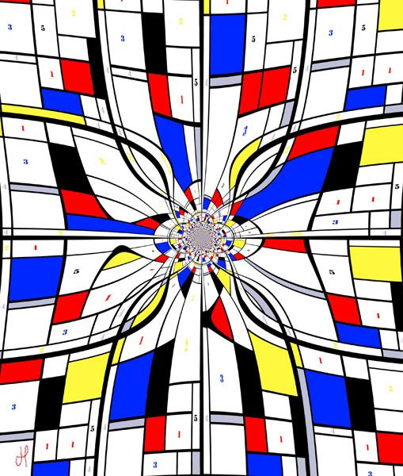


On the Effectiveness of Logic in Algorithmic Graph Theory
Martin Charles Golumbic − University of Haifa, Israel
Dedicated to our friend and colleague
Jean Louis Lassez

Slide 2
How have logic and algorithmic graph theory
influenced each other?
Hey Google:
“Are there any connections between graph theory and mathematical logic?”
YES! According to Martin Charles Googlumbic:
Read-once Boolean functions (cograph recognition factors it so each variable appears once)
The split graph sandwich problem is polynomial-time solvable (proof uses 2-SAT)
Temporal reasoning (the tractability of fragments of Allen's interval relations)
Logic and hypergraphs (hyperedges represent implications)
Finite automata and state machines (graphs with logical structure - a language for verification)

Slide 3
Moshe Vardi 1999: Automated Verification = Graphs, Automata, and Logic
“This holy trinity gave rise to automated-verification tools.”
Moshe Vardi 2015: Constraints, Graphs, Algebra, Logic, and Complexity
“Problems in database query optimization, machine vision, belief maintenance, scheduling, temporal reasoning, type reconstruction, graph theory, and satisfiability can be recast as questions regarding the existence of homomorphisms between two directed graphs.”
[Since] “constraint-satisfaction is NP-complete, this motivated an extensive research program into identify tractable cases of CSP.”
“Tools from graph theory, universal algebra, logic, and complexity theory, shed light on the tractability of constraint satisfaction.”
Let’s see how this plays out on examples of graph sandwich problems.

Slide 4
Logic and graph theory form the basis of a fascinating interplay
between combinatorial structures and their algorithmic properties.
Examples of this are
relations between logic, hypergraphs and constraint satisfaction
graph width parameters and Boolean functions,
connections with monadic second-order logic and complexity.
This has had an important impact on applications in computer science
database query optimization
temporal reasoning
verification
identifying tractable cases of relevant constraint satisfaction problems.
How have logic and algorithmic graph theory have influenced each other?

Slide 5
Dealing with Partial Information, Missing Data and Deducing Consistency
Sandwich Problems
For Graphs: guessing and filling-in missing edges
Take your favorite graph property Π
Remark.
The Classical Recognition Problem is the case where E⁰ = ∅
nothing optional !
Input: - a vertex set V
- a mandatory edge set E¹
- an optional edge set E⁰
Question: Is there a (sandwich) graph G = (V, E)
with E¹ ⊆ E ⊆ E¹ ∪ E⁰ that satisfies property Π ?

Slide 6
Example: The Chordal Graph Sandwich Problem
chordal graph: every cycle of length > 4 has a chord
No chordless cycles
G¹ = (V, E¹)
G = (V, E)
G² = (V, E¹ ∪ E⁰)
Theorem. The chordal graph sandwich problem is NP-complete.
Remarks. (1) The hypergraph analogue of chordal graphs are the
acyclic hypergraphs used in relational databases.
(2) A graph H has treewidth at most k, if and only if H is a subgraph
of a chordal graph G that has maximum clique size at most k+1.

Slide 7
The Split Graph Sandwich Problem
Split graph G is defined by any of these equivalences:
(1) the vertices can be partitioned V = K ∪ S
into a clique K and an independent set S.
(2) G and its complement G are chordal graphs.
(3) G is {C₄, C₅, 2K₂}-free
Theorem. The split graph sandwich problem is polynomial.
Proof. Can we find a partition V = K ∪ S with a valid fill-in?
Clearly if xy is a mandatory edge (in G¹) then x and y cannot both be in S.
Similarly, if xy is forbidden (in G¹ ∪ G⁰ ) then x and y cannot both be in K.
We represent these constraints by a set of Boolean clauses:

Slide 8
For each vertex w, define a Boolean variable W,
where W will be true iff w ∈ K.
The Boolean clauses:
(X ∨ Y ) for every xy ∈ E(G¹ ) at least one of x or y must be in K
and (X ∨ Y ) for every xy ∈ E(G¹ ∪ G⁰) at least one of x or y must be in S
Lemma. There exists a split sandwich if and only if this system is consistent.
Complexity: The transformation of the problem into the set of constraints
is easily seen to be O(|V|²).
Since this system is an instance of 2-SAT, it is solvable in be O(|V|²)-time.

Slide 9
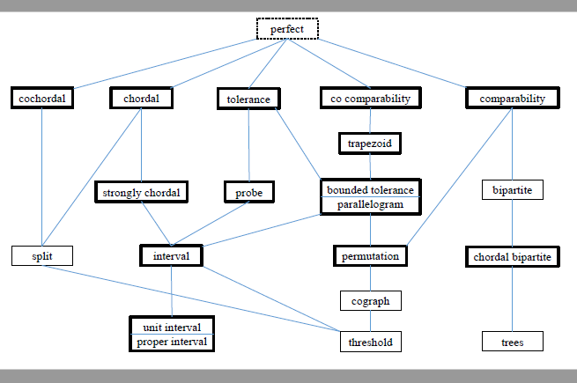
Sandwich Graph Complexty BOLD is NP-complete LIGHT is polynomial
A Hierarchy of Graph Classes

Slide 10
A story told by Moshe Vardi in 2015
When Moshe was in 4th grade, an 8th grader told him,
"I can draw a straight line passing through any 3 given points."
Moshe, being a rather a smart boy, replied,
"No, you can draw a straight line only between 2 points,
not through 3 points."
The older student said,
"Yes you can, if the line is thick enough."
This joke was Moshe's introduction to treewidth:
“Any graph G can be decomposed into tree,
by squishing parts of it together.”

Slide 11



Thanks

